Slide 1

University of Central Florida COP 3330 Object Oriented Programming

Slide 2
Agenda
Operators

Slide 3
Operators

Slide 4
Operators
Operators are special symbols that perform specific operations on one, two, or three operands, and return a result
Operators precedence
Operators with higher precedence are evaluated before operators with relatively lower precedence
Operators of equal precedence in the same expression are evaluated
Binary operators except for the assignment operators are evaluated from left to right
Assignment operators are evaluated right to left

Slide 5
Operator Precedence
Operators | Precedence
postfix | expr++ expr--
unary | ++expr --expr +expr -expr ~ !
multiplicative | * / %
additive | + -
shift | << >> >>>
relational | < > <= >= instanceof
equality | == !=
bitwise AND | &
bitwise exclusive OR | ^
bitwise inclusive OR | |
logical AND | &&
logical OR | ||
ternary | ? :
assignment | = += -= *= /= %= &= ^= |= <<= >>= >>>=

Slide 6
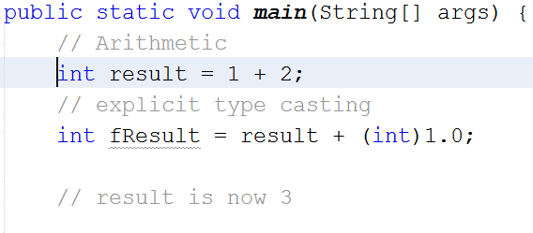
Operators
Assignment Operator
=
Assigns the value on its right to the variable on the left
The variable result stores the addition of 1 + 2

Slide 7
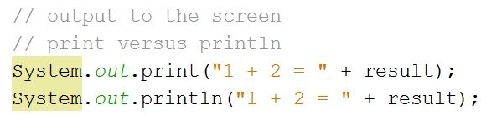
Operators
Outputting to the console or screen use methods:
System.out.print()
No line break
System.out.println()
Includes line break

Slide 8
Operators
Arithmetic Operator
Perform addition, subtraction, multiplication, division, and modulus (i.e. "%", divides one operand by another and returns the remainder as the result)
Operator | Description
+ | Additive operator (also used for String concatenation)
- | Subtraction operator
* | Multiplication operator
/ | Division operator
% | Remainder operator

Slide 9
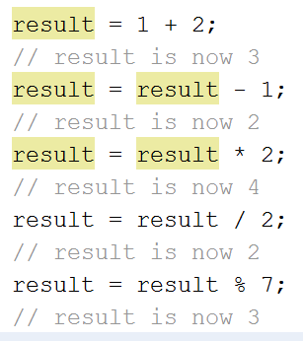
Operators
Arithmetic Operator
addition
subtraction
multiplication
division
modulus

Slide 10
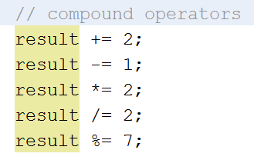
Operators
Compound Assignments
Combine the arithmetic operators with assignment operator
Example
x+=1; and x=x+1; both increment the value of x by 1

Slide 11
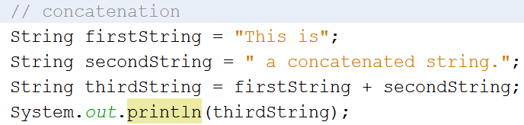
Operators
The + operator also be used for concatenating (joining) two strings together or other data

Slide 12
Operators
Unary Operators
Operator | Description
+ | Unary plus operator; indicates positive value (numbers are positive without this, however)
- | Unary minus operator; negates an expression
++ | Increment operator; increments a value by 1
-- | Decrement operator; decrements a value by 1
! | Logical complement operator; inverts the value of a boolean

Slide 13
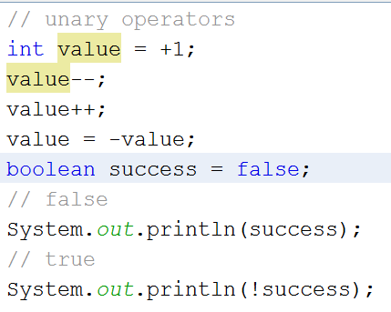
Operators
Unary Operators
require only one operand
perform various operations
incrementing/decrementing a value by one
negating an expression
inverting the value of a boolean

Slide 14
Operators
Prefix and Postfix
Prefix = increment/decrement operators applied before the operand
Postfix = increment/decrement operators applied after the operand.
Code result++; and ++result; will both end in result being incremented by one
Difference
prefix ++result evaluates to the incremented value
postfix result++ evaluates to the original value
performing a simple increment/decrement doesn't matter which version is used
if this operator is part of a larger expression, the selected implementation may make a significant difference.

Slide 15
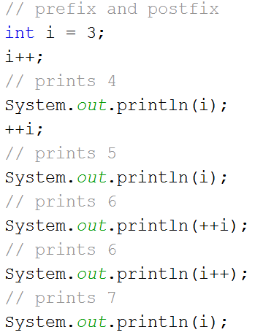
Operators
Prefix and Postfix
For the most part programmers will not notice a difference in behavior of prefix and postfix
In the example to the right it would be noticeable where the prefix and postfix are passed as arguments to the println() method
The printing is one independent action
The incrementing is a second independent action

Slide 16
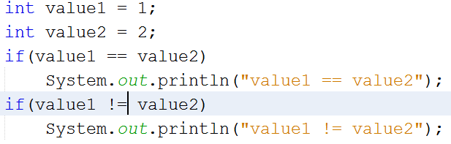
Operators
Equality and Relational
equality and relational operators determine if one operand is greater than, less than, equal to, or not equal to another operand
== equal to
!= not equal to

Slide 17
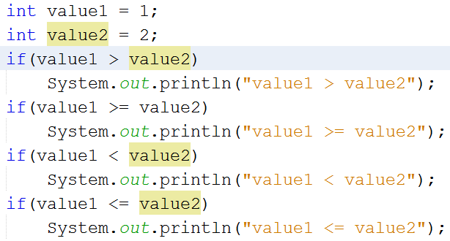
Operators
Equality and Relational
> greater than
>= greater than or equal to
< less than
<= less than or equal to

Slide 18
Operators
Conditional
&& and || operators perform Conditional-AND and Conditional-OR operations on two boolean expressions
these operators exhibit "short-circuiting" behavior, which means that the second operand is evaluated only if needed
Ternary operator ?:
shorthand for an if-then-else statement
ternary operator because it uses three operands

Slide 19
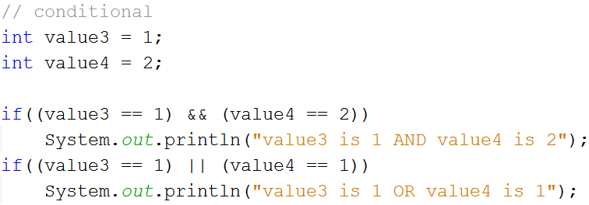
Operators
Conditional

Slide 20
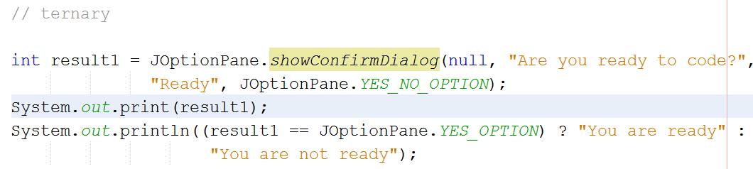
Operators
Conditional
Ternary operator ?:
Read as
If the result of the condition (result1 == JOptionPane.YES_OPTION) is true then the result the behavior coded in between the ? and the : is executed
If the result of the condition (result1 == JOptionPane.YES_OPTION) is false then the result the behavior coded in between the : and the ; is executed

Slide 21
Logical Operators
&& (AND)
Expression on the left of the && is true (nonzero)
AND
Expression on the right of the && is true (nonzero)
Truth table
Expression 1 | Expression 2 | Expression 1 && Expression 2
false | false | false
false | true | false
true | false | false
true | true | true

Slide 22
Logical Operators
|| (OR)
Expression on the left of the || is true (nonzero)
OR
Expression on the right of the || is true (nonzero)
Truth table
Expression 1 | Expression 2 | Expression 1 && Expression 2
false | false | False
false | true | True
true | false | True
true | true | True

Slide 23
Logical Operators
! (NOT)
Logical negation, logical complement
Reverses the evaluation of the condition
Truth table
Expression | !Expression
false | True
true | False

Slide 24
Operators
instanceof
instanceof operator compares an object to a specified type
use to test if an object is
an instance of a class
an instance of a subclass
an instance of a class that implements a particular interface

Slide 25
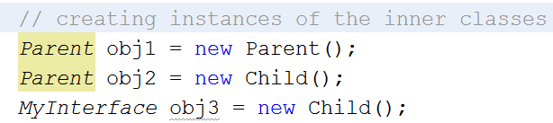
Operators
Using an inner class
In the outer class create instances of the inner classes
This declaration is in the main() method of class Operators

Slide 26
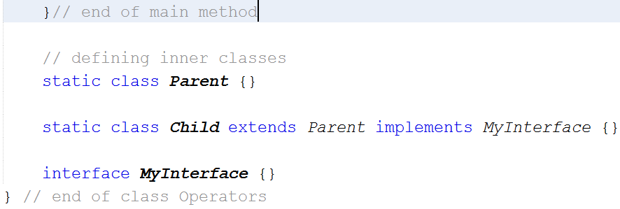
Operators
Defining an inner class
In object oriented programming classes can contain inner classes, classes that are defined within a class
Are private to the class they are defined in

Slide 27
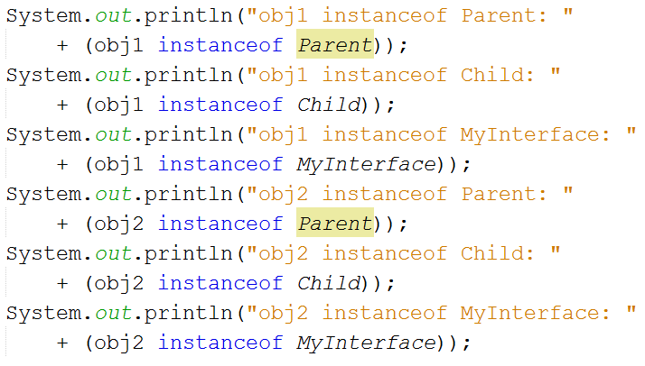
Operators
Checking instanceof
Using the instanceof operator each object is checked

Slide 28
Operators
Checking instanceof
obj1 is an instanceof inner class Parent because the statement called the Parent() constructor
Parent obj1 = new Parent();
obj1 is NOT an instanceof inner class Child because the statement did not call the Child() constructor
obj1 is NOT an instanceof inner interface MyInterface because the class Parent did not implement the interface MyInterface

Slide 29
Operators
Checking instanceof
obj2 is an instanceof inner class Parent because class Child extended class Parent
Parent obj1 = new Parent();
obj2 is an instanceof inner class Child because the statement called the Child() constructor
obj2 is an instanceof inner interface MyInterface because the class Child implemented the interface MyInterface

